Slide 1
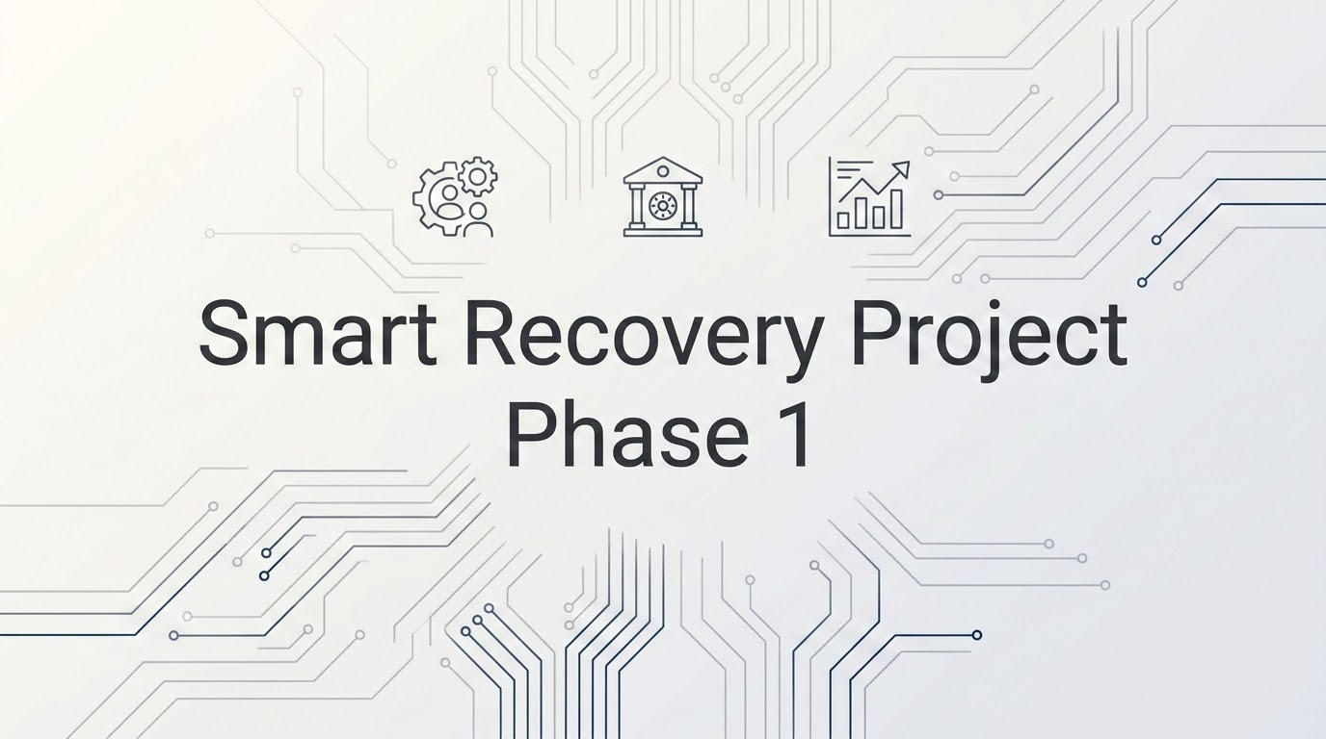

Slide 2

Strategic Recommendations
Approve immediate development of the Phase 1 Portal Bundle (OPP-01, 03, & 05)
engineering
payments
gavel
Operational Efficiency
Eliminate critical agent labour bottlenecks across fragmented systems.
Financial Gain
Capture over £24,000 in net annual benefit.
Risk Mitigation
Safely absorb long-term compliance reporting costs and reduce audit risks.
Smart Recovery Initiative - Discovery Package Output
Notes:
We are here to discuss a critical turning point for Legacy Trust’s collections operations. Today, I am recommending the immediate development and funding of our Phase 1 Portal Bundle, which combines OPP-01 (automate status checks) , OPP-03 (atomate analytics and end of month reporting,) and OPP-05 (Automate the scheduling of follow ups with agents)..
Let's look at what this investment achieves:
First, Operational Efficiency: This bundle targets bottlenecks caused by the volume of manual administration faced by Gareth’s team. By automating customer status inquiries and follow-up tracking, we free up thousands of hours of capacity which agents can use to address the cases that really need them.
Second, Financial Gain: This deployment is highly profitable. Phase 1 requires a total implementation cost of £42,320.00, but it should generate a gross annual benefit of £66,756.09. This means the net annual profit will be +£24,436.09 in the very first year.
Third, Risk Mitigation: OPP-03 is strategically necessary as it builds the data log and audit trails mandated by UK FCA guidelines. Without it we would be exposing the bank to catastrophic compliance fines that could easily reach hundreds of thousands of pounds.

Slide 3
The Core Problems
The Annual Labor Leak
The manual current state requires exactly 2,391.80 hours of manual work annually across routine status checking and administrative follow-up tracking alone.
The Financial Burden
At our standard baseline cost, this operational drain drains £52,619.60 in human resource capacity every single year.
The Revenue Leakage Layer
The bank suffers an extra £10,617.37 in direct revenue leakage annually from active arrangement collapses because overwhelmed agents lack capacity to follow up.
The Process Breakdowns
OPP-01: 1,269.40 hours on status checks.
OPP-05: 1,122.40 hours on follow-up scheduling.
Smart Recovery Initiative - Discovery Package Output
Notes:
Gareth, Priya, Daniel—let’s look at why the current manual state is entirely unsustainable.
Right now, our collections team is losing 2,391.80 hours of manual work every single year just processing basic administrative tasks. At our baseline agent cost, that equates £52,619.60 annually wasted on routine administration rather than high-value customer negotiations.
Worse still, because our agents are completely buried under this administrative work, we are experiencing an extra £10,617.37 in direct revenue leakage annually. This is because active payment arrangements quietly collapse in the background, and we lack the capacity to follow this up. When you look at the breakdown, OPP-01 status checks consume nearly 1,270 hours, and OPP-05 manual tracking takes up over 1,120 hours. This means the team are being paid to be data entry messengers, not collections experts.

Slide 4
Discovery Evidence and Pain Points
Information Asymmetry
Customers have no self-service visibility, forcing high volumes of simple inbound balance inquiries.
The Follow-Up Black Hole
Broken promises to pay fall through the cracks because agents lack an automated scheduling mechanism to track and match payments.
The Technical Reality
The current system relies on manual tracking sheets and fragmented logs, leaving zero audit trails for compliance.
User Story Alignment
User research shows an immediate need for an identity-verified portal to systematically handle routine interactions.
Smart Recovery Initiative - Discovery Package Output
Notes:
Our discovery phase exposed three critical friction points.
First, we have severe lack of easily available information. Customers have no self-service visibility, forcing them to call up just to check their balance. Second, we suffer from a 'Follow-Up Black Hole'. This means when a customer breaks a promise to pay, it gets lost in the system as there is no automated trigger to prompt an agent.
The final friction point is that our team is surviving on fragmented, manual spreadsheets. This leaves us with no audit trails, which puts us in a precarious regulatory position. Our user research confirms that both our customers and our staff are crying out for a secure, identity-verified portal to handle these routine interactions.

Slide 5
ROI
Opportunity ID | Focus Area | Implementation Cost | Annual Benefit | Net 12-Month Value | 12-Month ROI
OPP-01 | Automated Status Checks | £18,800.00 | £27,926.80 | +£9,126.80 | 48.55%
OPP-03 | End-of-Month Analytics | £9,440.00 | £3,519.12 | -£5,920.88 | -62.72%
OPP-05 | Follow-Up Scheduling | £14,080.00 | £35,310.17 | +£21,230.17 | 150.78%
TOTALS | Phase 1 Combined Bundle | £42,320.00 | £66,756.09 | +£24,436.09 | 57.74%
Smart Recovery Initiative - Discovery Package Output
Notes:
Let’s address the numbers
To implement phase 1 we require an investment of £42,320.00. This bundle will deliver an annual benefit of £66,756.09, resulting in a net 12-month value of +£24,436.09 and a ROI of 57.74%.
Regarding OPP-03, our End-of-Month Analytics module, this shows a net loss of -£5,920.88. In a vacuum, we might cut this. However, we have intentionally bundled it into Phase 1 because it builds the foundation of data Daniel needs for risk auditing. Because OPP-05 is highly profitable with a 150.78% ROI, it completely absorbs the cost of our analytics framework, keeping the phase profitable whilst shielding the bank against regulatory penalties.

Slide 6
Scope and exclusions
IN-SCOPE CAPABILITIES (PHASE 1 FUNDING)
Identity Verification (MFA Login Gate)
Full MFA matching customer records. FCA Guardrail: 3 failed attempts triggers lock and proactive outreach.
Account Summary Dashboard (OPP-01)
Clean frontend interface for balances and outstanding money, deflecting routine agent inquiries.
Promise to Pay Setup (OPP-05)
Structured repayment portal. Affordability Guardrail: Instant agent escalation if repayment exceeds income.
Automated Workflow Alerts (OPP-05)
Backend triggers for missed deadlines, rescuing £10,617.37 in arrangement leakage.
Data Auditing & Reporting (OPP-03): Immutable activity logs for FCA compliance; absorbs a net yield of -£5,920.88.
🚫 EXCLUDED / DEFERRED CAPABILITIES (PHASE 2)
Live API Write-Paths (OPP-04): Batched via read-only SFTP to protect core banking system.
Automated Ingestion (OPP-02) / Advanced Routing: Deferred for stability; vulnerable users stay with human agents.
Smart Recovery Initiative - Discovery Package Output
Notes:
To ensure we protect the bank's legacy architecture, we have drawn a very strict line around our product scope.
In-scope capabilities include the core MFA Login Gate, featuring an FCA compliance guardrail that will lock accounts after 3 failed attempts and alerts Gareth’s team. We are also funding the read-only Account Dashboard and the Promise to Pay setup, which contains an affordability guardrail to instantly flag and escalate cases if a proposed plan exceeds a customer's logged income.
What we are excluding in phase 1 is also important. We are deferring live API write-paths to the 20-year-old database under OPP-04. Instead, the portal will batch data into a daily midnight CSV, dropped via a secure, read-only SFTP file sync. This delivers full automation to operations without risking a catastrophic crash of the legacy system.

Slide 7

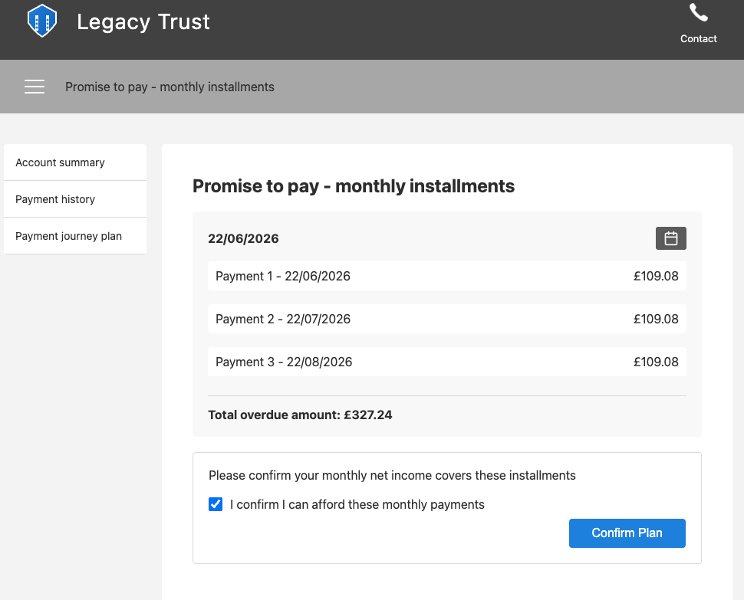
Backlog and Prototype
De-Risked User Experience
An interactive HTML/CSS prototype built to map core journeys, translating user stories into scannable layouts for verification, the Account Dashboard and 3-Month Plan Calculator.
Built-In Exception Safeguards
Interface demonstrates automated boundary controls mandated by strategy:
MFA Lockout: Displays agent helpline after 3 invalid token attempts.
Affordability Alert: Halts journey and escalates to live queue if payments exceed income.
Backlog Maturity
All primary user pathways are written as engineering-ready stories. Development can commence immediately upon Phase 1 approval.
Smart Recovery Initiative - Discovery Package Output
Notes:
As you can see by the UI interface displayed on this slide, we have already developed a fully functional, low-fidelity HTML prototype to explore the capabilities of phase 1.
This prototype proves that our core user journeys and exception guardrails work in practice. The income validation checkbox and automated agent-routing rules are already mapped out. Furthermore, all primary pathways are documented as engineering-ready user stories in our backlog. The engineering team can begin development the day we receive budget sign-off.

Slide 8
Change risks and mitigations
Risk 1: Legacy Database Instability
Mitigation: Phase 1 completely avoids live API write-paths. Instead, data is synced safely using an automated midnight read-only SFTP daily batch export.
Risk 2: Standalone Loss on OPP-03 Reporting
Mitigation: Accept the individual net loss of -£5,920.88 because launching it now delivers the critical audit log trail required by UK FCA guidelines. The cost is fully absorbed by the massive surplus of OPP-05.
Risk 3: Customer Vulnerability & Hardship Handling
Mitigation: Built-in front-end safety valves instantly route users to manual agent queues with explicit context metadata strings, preventing regulatory breaches.
Smart Recovery Initiative - Discovery Package Output
Notes:
Before we ask for formal approval, let’s talk about risk mitigation.
Our highest technical risk is legacy database instability. We have completely mitigated this by enforcing the midnight read-only SFTP file batch sync rather than direct live writes. Our financial risk is the standalone loss on OPP-03 reporting, which we have mitigated by using the massive surplus of OPP-05 to absorb the cost, giving us critical compliance tracking for free.
Finally, to mitigate any vulnerability or customer hardship risks, the frontend includes automated safety valves. If a customer flags distress, the portal instantly bypasses automated calculations and drops them into a priority manual queue with context provided, ensuring regulatory alignment.

Slide 9
Summary
Authorize the formal allocation of the £42,320 Phase 1 budget to deliver the Smart-Recovery Portal bundle (OPP-01, 03, & 05).
£24,400
12-MONTH NET PROFIT
2,300 hrs
MANUAL CAPACITY UNBLOCKED
Smart Recovery Initiative - Discovery Package Output
Notes:
To wrap up: the data shows that the cost of doing nothing is a continuous drain on our staff and our revenue.
By allocating the £42,320 Phase 1 budget today, we will unblock 2,300 hours of manual agent capacity, secure our legacy systems, and pocket a £24,400 net profit within 12 months. The prototype is validated, the risk is mitigated, and we are ready to build.
Thank you, and I will now open the floor to your questions.

